Slide 1
HTML

Slide 2
Agenda
What is HTML
Tools
Page Structure
Quiz
Assignment

Slide 3
What Is HTML?

Slide 4
What Is HTML?
HTML stands for Hyper Text Markup Language
HTML is not a programming language.
HTML is the standard markup language for creating Web pages
HTML elements tell the browser how to display the content
HTML describes the structure of a Web page

Slide 5
What Is HTML?
HTML elements tell the browser how to display the content
HTML elements label pieces of content such as "this is a heading", "this is a paragraph", "this is a link", etc.

Slide 6
What Is HTML?
<!DOCTYPE html>
<html>
<head>
<title>Page Title</title>
</head>
<body>
<h1>My First Heading</h1>
<p>My first paragraph.</p>
</body>
</html>

Slide 7
What Is HTML?
World Wide Web Consortium are making the standards

Slide 8
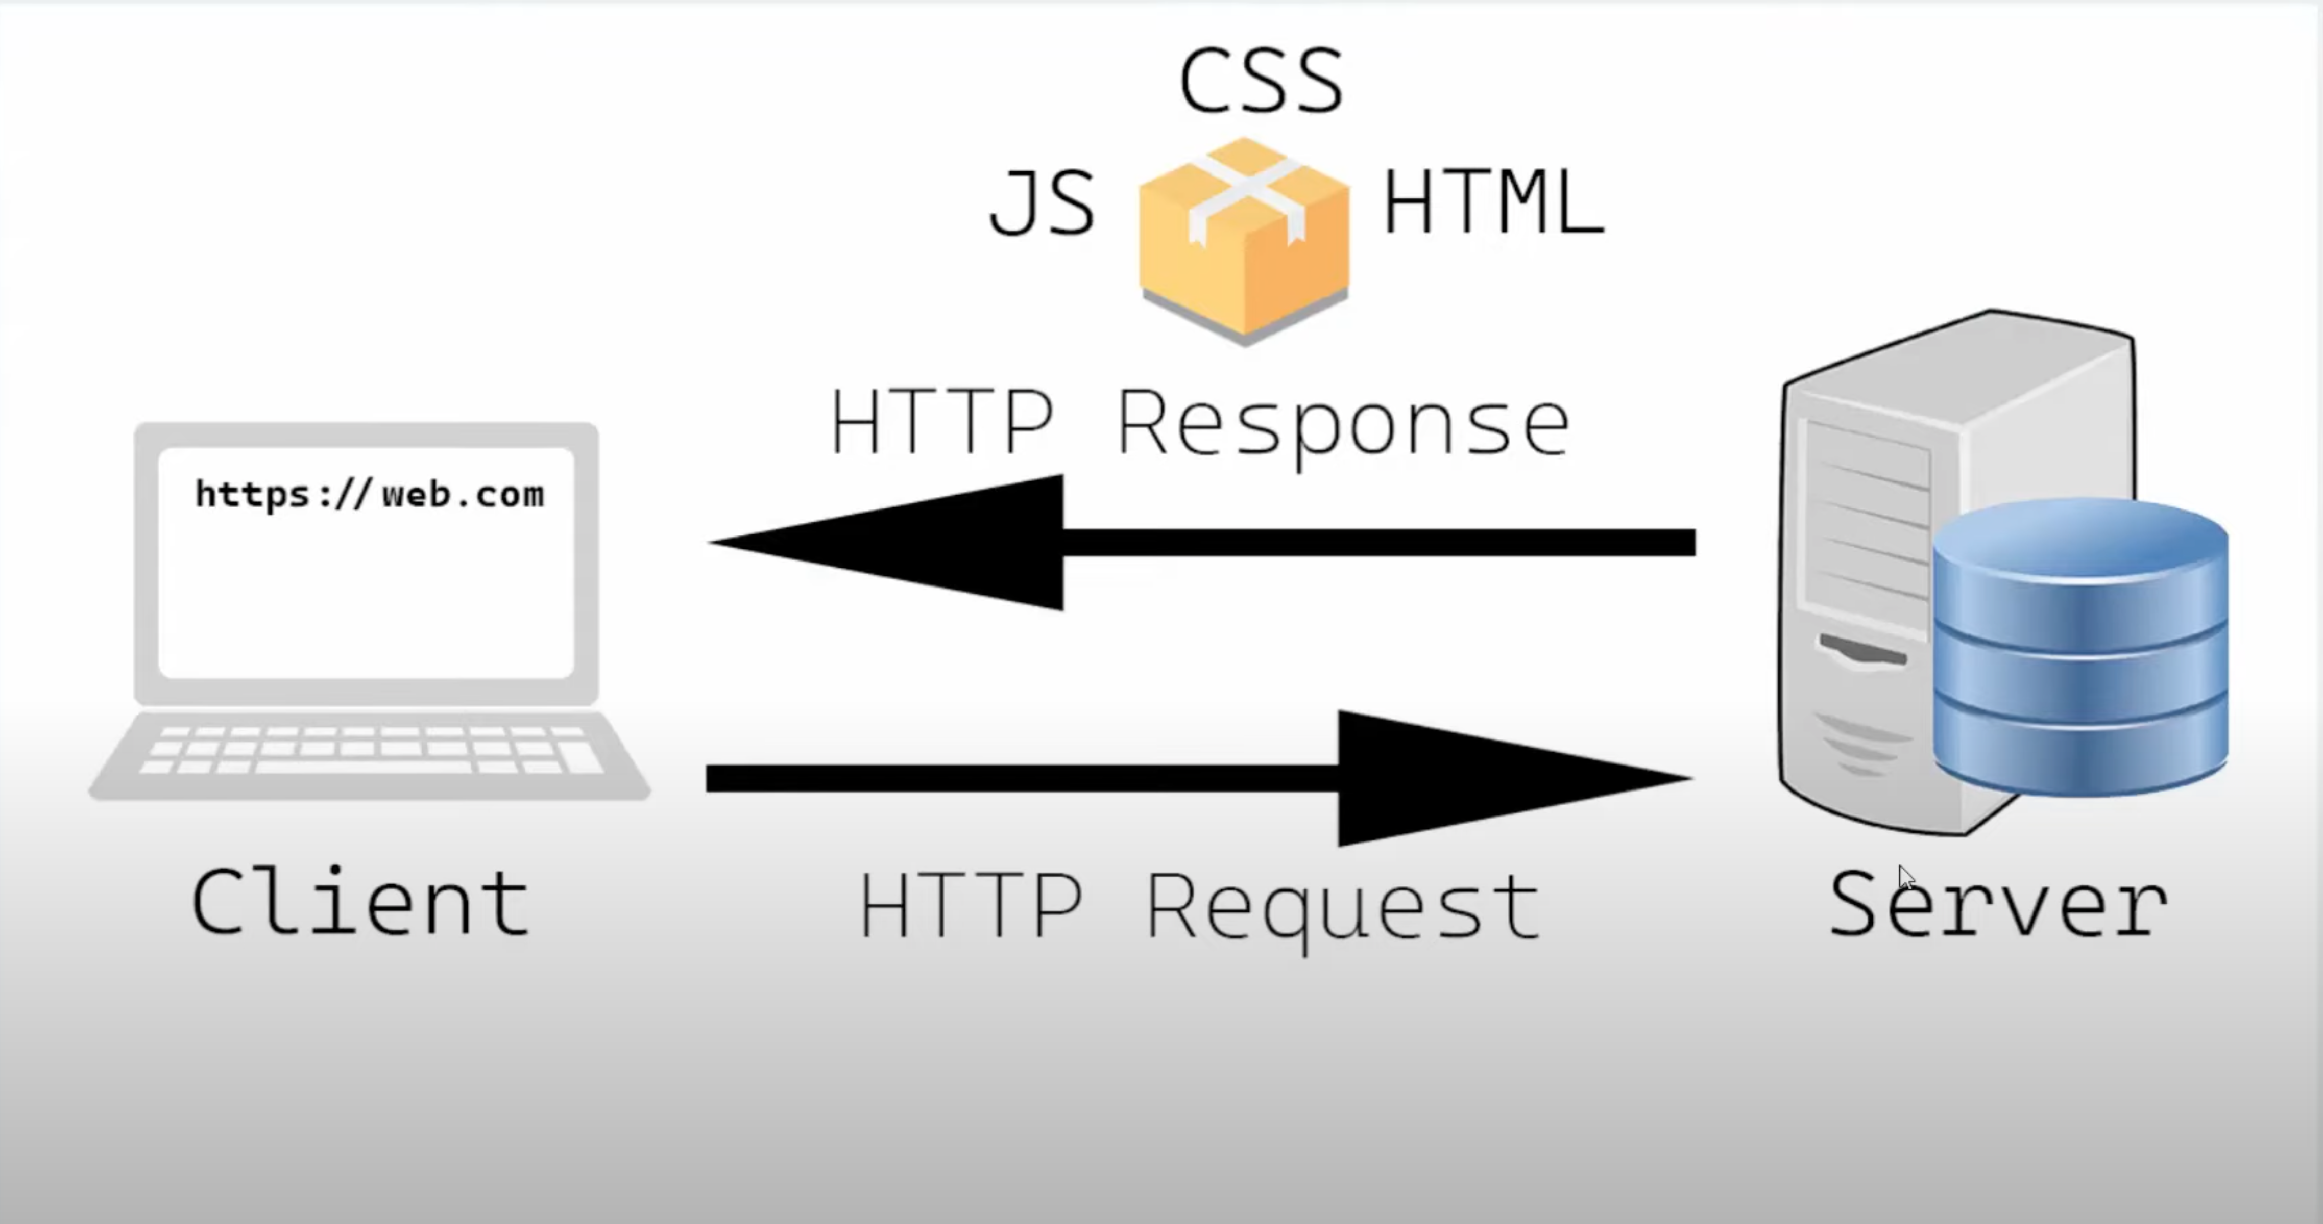

Slide 9
Tools needed

Slide 10
Tools
Visual Studio Code – editor
Prettier – formatting tool
LiveServer
Chrome / Firefox

Slide 11
Page Structure

Slide 12
Page Structure – HTML Tags
<html>
<head>
<title>
<h1> <h2> … <h6>

Slide 13
Page Structure – HTML Tags
<p>
<!-- -->
<b> <i> <u> <em>

Slide 14
Page Structure – HTML Tags & Attributes
<ul></ol> <ol></ol> <li></li>
<br> <hr>
<img attribute-name=“something”>
<input type=“password”> <button> <label>

Slide 15
Page Structure – HTML Tags & Attributes
<div> <span>
<table> <th> <tr> <td>
<form action="/action_page.php"> <label for="fname">First name:</label><br> <input type="text" id="fname" name="fname" value="John"><br> <label for="lname">Last name:</label><br> <input type="text" id="lname" name="lname" value="Doe"><br><br> <input type="submit" value="Submit"> </form>

Slide 16

Live Server
What is a server

Slide 17
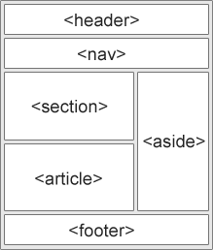
Page Structure - Semantic Tags
<header>
<nav>

Slide 18
Page Structure - Semantic Tags
<article>
<aside>
<details>
<figcaption>
<figure>
<footer>
<header>
<main>
<mark>
<nav>
<section>
<summary>
<time>

Slide 19
Page Structure - Semantic Tags
<article>
<aside>
<details>
<figcaption>
<figure>
<footer>
<header>
<main>
<mark>
<nav>
<section>
<summary>
<time>

Slide 20
Page Structure - Meta Tags
<meta charset=“UTF-8”>
<meta name=“description” content=“Fast Track IT curs”>
<meta name=“author” content=“Alex Ghiurau”>
<meta name=“viewport” content=“width=device-width, initial-scale=1.0”>

Slide 21
Page Structure - Script & Link Tags
<script src=“./index.js” type=“text/javascript”></script>
<link rel=“stylesheet” href=“style.css”>
Or inline
<script></script>
<style></style>

Slide 22
Page Structure – Automatic generation
<meta charset=“UTF-8”>
<meta name=“description” content=“Fast Track IT curs”>
<meta name=“author” name=“Alex Ghiurau”>
<meta name=“viewport” content=“width=device-width, initial-scale=1.0”>

Slide 23
Page Structure – A href
<a href=“./somethingelse.html”>

Slide 24
Quiz

Slide 25
Assignment

Slide 26
Assignment
Using the knowledge you gained so far
1. Creați 4 pagini HTML care să aibă (fiecare) linkuri spre celelalte două pagini. O pagină va fi pagina principală, a doua va conține un CV, a treia o listă cu cărțile/filmele preferate, iar a 4a o pagina cu statistici sub forma de table (ex. Pacienti covid pentru un judet).
2. Pe fiecare pagină să existe cel puțin două poze, 3 paragrafe, o listă și un tabel. Linkurile să fie chiar pozele, nu un text.
3. Studiați în special tagurile <div> <form> <label> <input>

Slide 27
Ex Statistics
Will contain <p> <div> <a> <table> <th> <tr> <td>
Reference to index and contact page
Display a table having the following data
Nr
County (10 county’s are enough)
Total cases
Population

Slide 28
Assignment – Referecences
https://www.w3schools.com/tags/default.asp (gasiti in stanga toate tagurile si docs)
https://marksheet.io/html-links.html (cititi cu atentie pentru a implementa extra points in index)
https://developer.mozilla.org/en-US/docs/Web/HTML/Reference

